Slide 1


US Unemployment Analysis
Exploring decade-long labor trends, seasonal fluctuations, demographic disparities, and the early economic impact of COVID-19.

Slide 2

Project Overview
A comprehensive exploratory data analysis of United States unemployment rates from 2010 through early 2020.

Slide 3



Project Concept & Objectives
Core Project Idea
Primary Goals
Analyze micro and macroeconomic shifts in US employment across national demographic divisions (education, race, gender) and geographical state lines using multi-sourced historical datasets.
Identify long-term economic recovery indicators post-2010, quantify historical seasonality patterns, and evaluate early labor vulnerabilities right as the pandemic hit in early 2020.

Slide 4






Technology Stack & Tools
Python Core
Pandas & NumPy
Matplotlib & Seaborn
Primary analytical runtime for data parsing, structured processing, and statistical aggregation.
Used for dataset merging, datetime standardization, missing value handling, and grouping pivots.
Used to craft visual analytics, including multi-line trends, bar charts, and distribution plots.

Slide 5




Methodology & Execution Pipeline
2. Cleaning
4. COVID Shock
Standardized date formats, deduplicated rows, and handled null values.
Quantified initial Jan-Mar 2020 shifts across states and demographics.
1. Data Loading
3. Trend Analysis
Ingested national and state datasets covering 2010 to 2020.
Evaluated historical rates across race, education, gender, and season.

Slide 6


Technical Challenges & Limitations
1. Pandemic Data Truncation
2. Missing Values & Imputation
The national demographic tracking stopped reporting from April 2020 onward right as COVID-19 hit full force. Analysis of demographic pandemic impact had to rely strictly on early signs (Jan-Mar 2020).
State data contained missing entries (e.g., Puerto Rico March 2020). Rather than dropping territory rows, state-specific mean imputation was executed to preserve geographic completeness.

Slide 7
Results & Empirical Insights
Key visual findings derived from long-term economic data and state-by-state comparisons.

Slide 8

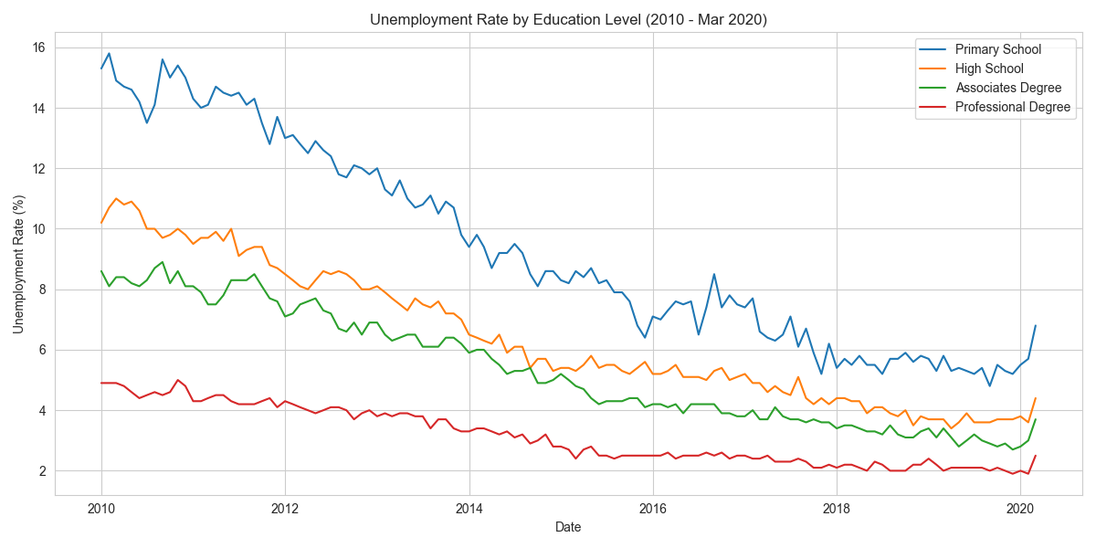
Long-Term Trend by Education Level
•
Persistent Gap: Individuals with Primary School education maintained significantly higher unemployment rates (~15% in 2010 to ~6% in 2020) than degree holders.
•
Steady Recovery: Across all educational brackets, unemployment steadily declined from 2010 to 2019 following the post-2008 economic recovery.
•
Early Uptick: A sharp upward hook is visible across all tiers in Q1 2020 as early pandemic disruptions began.

Slide 9
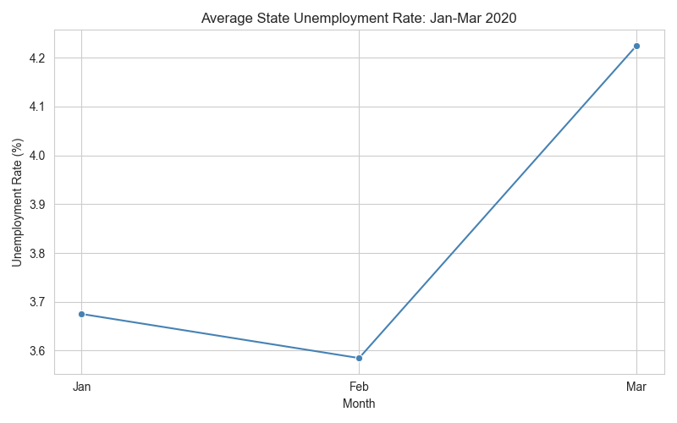
Initial COVID-19 Demographic Shift
•
Primary School Group Hardest Hit: Increased by nearly 0.4 percentage points within Q1 2020 compared to the 2019 average.
•
Racial Disparity: Hispanic and High School educated workers experienced the next largest initial jumps in unemployment rates.
•
Professional Degrees Resilient: Professional degree holders and higher education brackets showed minimal or delayed job loss impact in early 2020.

Slide 10
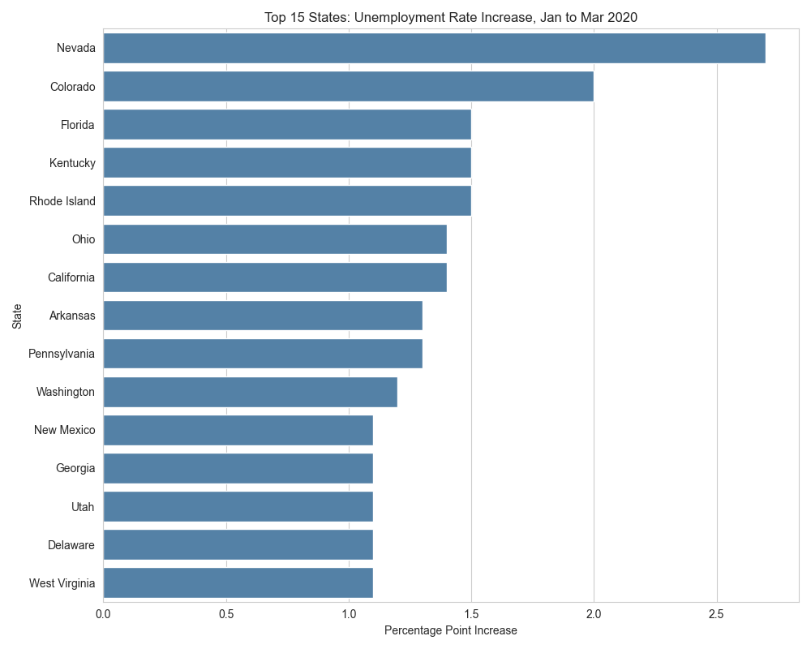
State-Level Early Pandemic Spikes
•
Nevada Outlier (+2.7%): Nevada experienced the steepest unemployment rise from Jan to Mar 2020 due to instant hospitality and tourism shutdowns.
•
Top Impacted States: Colorado (+2.0%), Florida (+1.5%), Kentucky (+1.5%), and Rhode Island (+1.5%) followed close behind.
•
National Average: The average state unemployment rate rose sharply from 3.58% in Feb to 4.23% in March 2020.

Slide 11
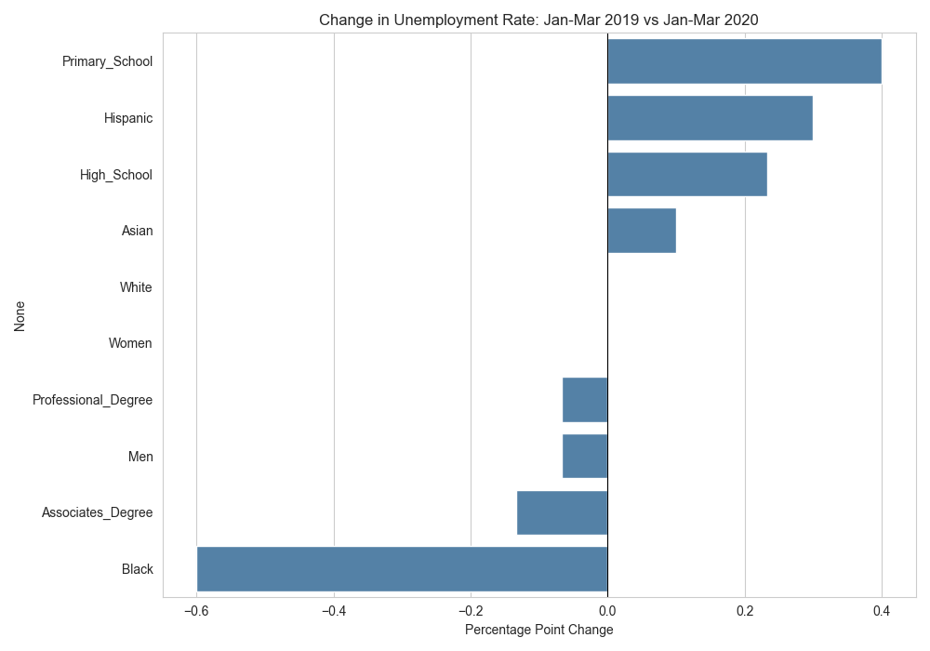
Pre-Pandemic Seasonality (2010-2019)
•
January Peak (~7.5%): Unemployment historically peaks in January and February due to post-holiday retail layoffs and seasonal winter slowdowns.
•
Late Year Lows (~6.8%): Rates steadily decline into Autumn and December as seasonal hiring accelerates.
•
Baseline Isolation: Isolating 2010-2019 ensured unusual 2020 economic shocks did not skew normal seasonal baseline expectations.

Slide 12
Key Takeaways & Conclusion
Education is Protective: Higher formal education levels consistently correlated with significantly lower baseline unemployment rates.
Early Shock Warning: Tourism and service-dependent states (like Nevada) acted as early warning indicators for the 2020 recession.
Data Awareness: Demonstrates the critical importance of handling real-world data limitations, such as missing demographic reporting during economic crisis periods.

